Slide 1
ORGANISATIONAL
BEHAVIOUR
CHAPTER-4
FOUNDATIONS OF INDIVIDUAL BEHAVIOUR

Slide 2
LEARNING OBJECTIVES
Issues confronting OB specialist in the days to come.
The various personal factors which influence individual behaviour.
The impact of environmental factors on individual behaviour.
How organisational systems and resources are a foundation to individual behaviour.
How individual behaviour is influenced by psychological factors.
The various behaviouristic models constructed by OB experts.

Slide 3
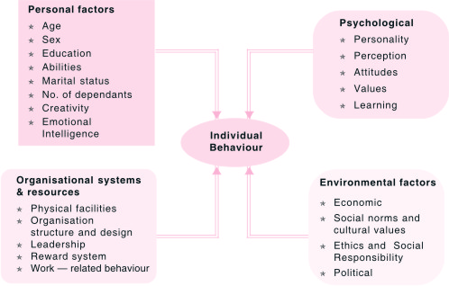
Foundations of Individual Behaviour

Slide 4
Dimensions of Intellectual Ability
Dimension Description Job Example
Number aptitude Ability to do speedy and accurate arithmetic Accountant: Computing the sales tax on a set of items
Verbal Ability to understand what is read or Plant Manager: Following Comprehension heard and the relationship of words corporate policies
to each other
Perceptual speed Ability to identify visual similarities and Fire Investigator: Identifying differences quickly and accurately clues to support a charge of arson
Inductive reasoning Ability to identify a logical sequence in a Market Researcher: Fore- problem and then solve the problem casting demand for a product in the subsequent time period
Deductive reasoning Ability to use logic and assess the Supervisor: Choosing implications of an argument between two different suggestions offered by employees
Spatial visualisation Ability to imagine how an object would look, Interior Decorator: Re- if its position in space were changed decorating an office
Memory Ability to retain and recall past experiences Salesperson: Remembering the names of customers

Slide 5
Nine Basic Physical Abilities
Strength Factors
Dynamic strength Ability to exert muscular force repeatedly or continuously
over time
Trunk strength Ability to exert muscular strength using the trunk
(particularly abdominal) muscles
3. Static strength Ability to exert force against external objects
Explosive strength Ability to expand a maximum of energy in one or a series
of explosive acts
Flexibility Factors
Extent flexibility Ability to move the trunk and back muscles as far
as possible
6. Dynamic flexibility Ability to make rapid, repeated flexing movements
Other Factors
Body coordination Ability to coordinate the simultaneous actions of different
parts of the body
8. Balance Ability to maintain equilibrium despite unbalancing forces
Stamina Ability to continue maximum effort requiring prolonged
effort overtime

Slide 6
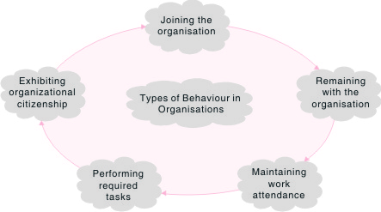
Stages in Organisational Life

Slide 7
Summary
Personal factors such as age, sex, education, abilities, marital status, and dependents will have significant influence on the behaviour of an individual.
Environmental factors include economic status, social and cultural norms, and political factors. These also wield considerable influence on individual behaviour.
Organisational systems and resources include such variables as physical facilities, organisation structure and design, leadership rewards and work itself. The influence of all these on the behaviour of an individual is no less significant.
More important are psychological factors like personality, perception, learning, and attitudes. Because of their significance in determining one’s behaviour, each of these factors is considered separately in the following chapters.
The famous Theory X and Theory Y, along with other models, seek to explain the behaviour of an individual.

Slide 8
Key Terms
Abilities
Intellectual abilities
Physical abilities
Ability-job fit
Creativity
Cognitive abilities
Work ethic
Effort and reward
Work-related behaviour
Rational and emotional model
Behaviouristic and emotional model
Economic and self-actualizing model
Theory X and Theory Y model

